Slide 1
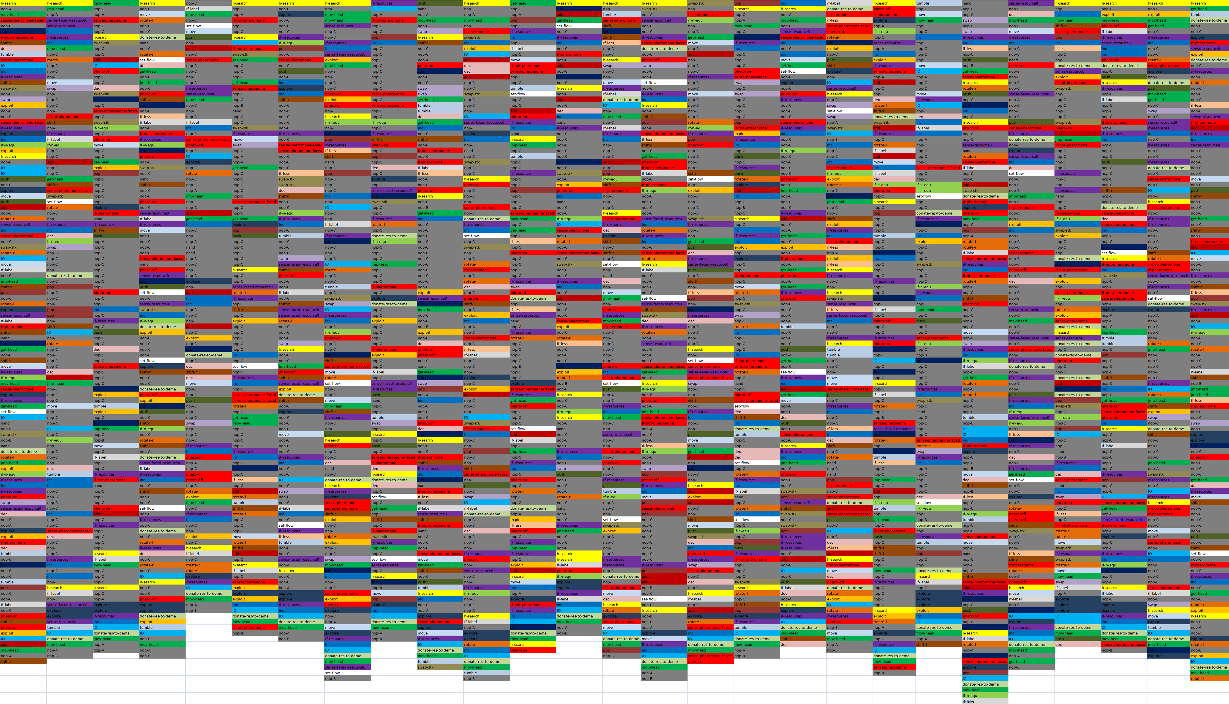
Too Many Instructions?

Slide 2
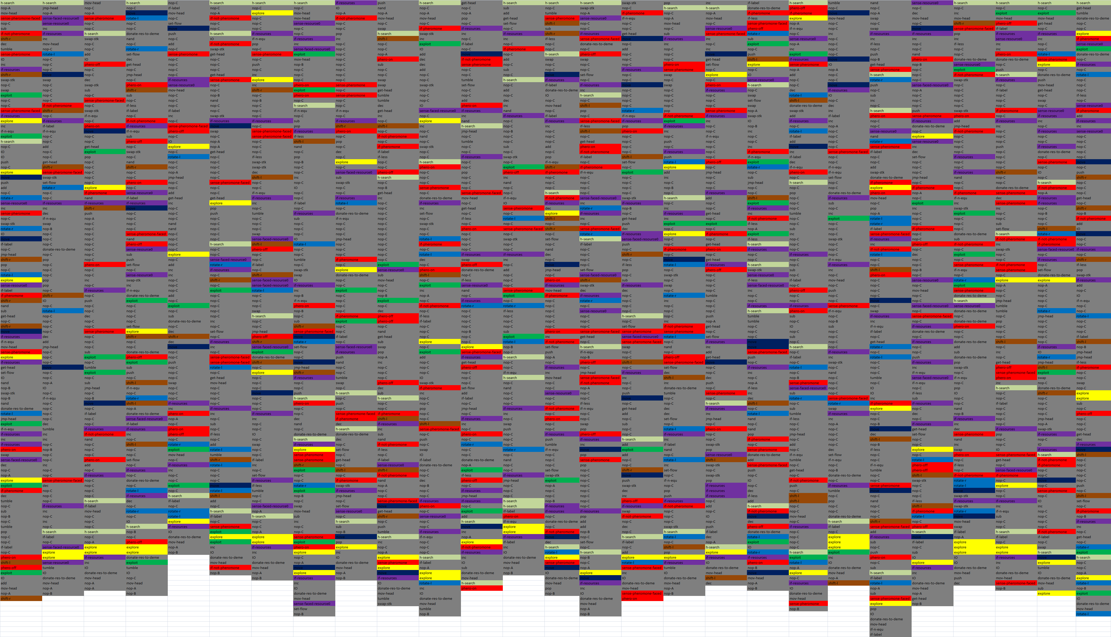
Basic Instructions From Original Paper
h-search
shift
explore
resource
pheromone
rotate
exploit
move

